Slide 1
EPC GAS GEN IMPROVEMENT PROJECT
Business Case/objectives:
The Egbema EPC Gas Gen is powered using fuel gas from Egbema FS, during outages there is a backup diesel generator at the FLB for power supply.
Due to frequent outage of TNP the diesel gen has become the main source of power leading to high costs for diesel consumption as well as wear and tear causing 3 catastrophic failures in the last 3 years
2017 FLB Diesel Gen consumption was ca400,000 liters of diesel, market value N80million, while first half 2018 FLB Diesel Gen Consumption at ca175,000 liters of diesel, market value N35million.
This project aims to explore available options and implement the best to facilitate continuous running of the gas gen during production outages.
Potential Benefits & Measurement:
Cost savings-reduced diesel consumption
Cost Savings- corrective maintenance of D/gen
Reputation- Improved power to NNPC & host communities
Improve welfare of POB
Project Scope/Actions :
Feasibility Studies
Assessment & Physical Verification of status of fuel gas system equipment
Carry out Risk Assessment, Process Safety/HAZOP reviews
Develop & Sign Off SOP & bridging/interface documentation
Execute & Implement Plans & Actions
Critical Success Factors:
Leadership support
NOV Support
Cross-function collaboration
Timely Delivery
High-level Timeline:
L0-L1: Carry out feasibility studies
L2: Secure approval from leadership
L3: Engage NOV/NPDC teams
L4: Process Safety/HAZOP reviews
L5: Implement/ Plan & Actions
Project Sponsor: Wilcox Emmanuel/Aniemeke Samuel
Initiative owner: John Nna-Okpabi/Ogbonna Innocent/Oboro Richardson
Project Team members: Nwalozie Collins, Okpara Darl, Oluwasegun Agbaje, Hart Alaidanengia , Dahunsi Olatunbosun, Ruth Micheal, Okpeze Tina, Anyaogu Uche

Slide 2
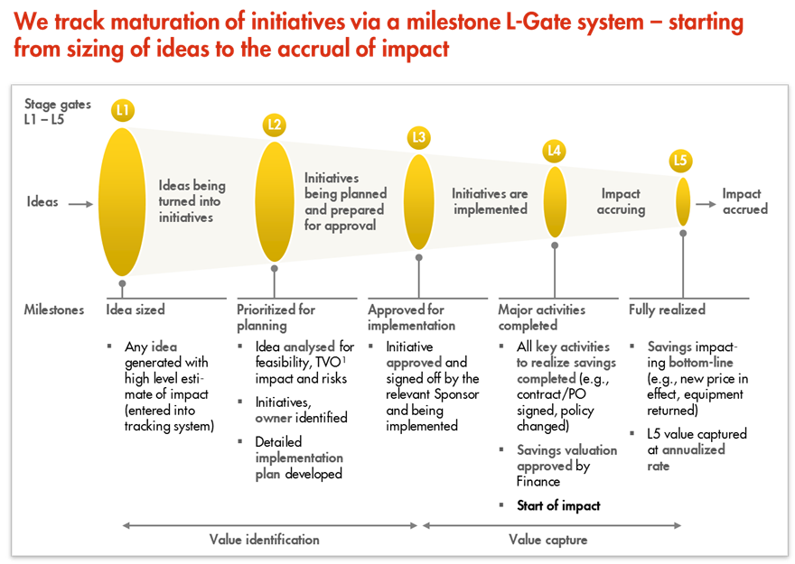
L1 – L5 Gates

